Slide 1
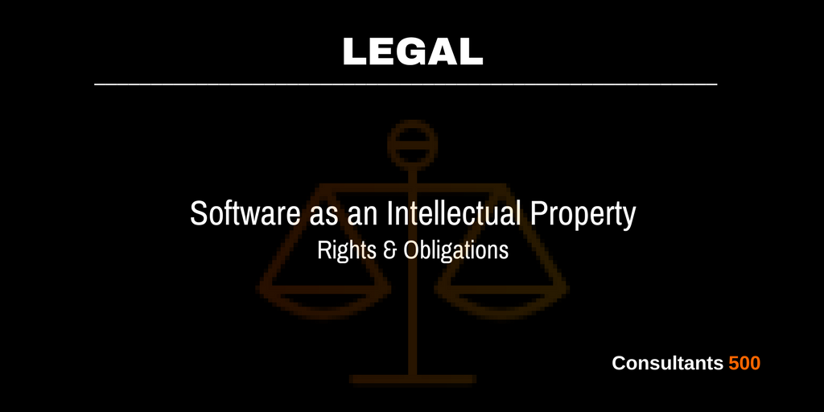
Chapter No. 7 Legal Challenges

Slide 2
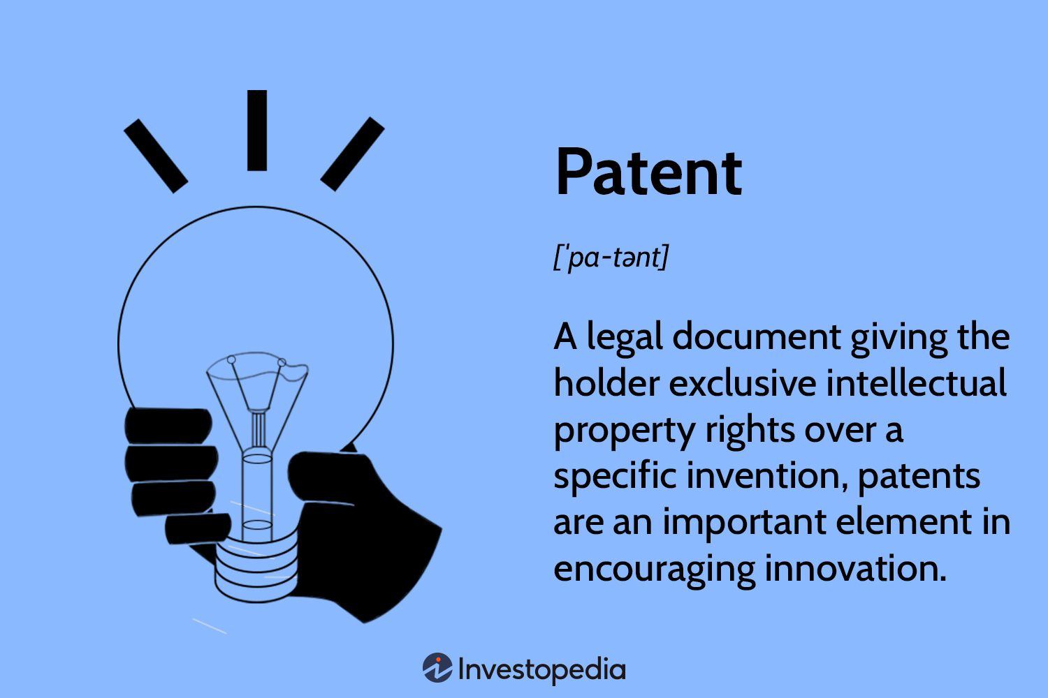
Intellectual Property Protection (Patents)

Slide 3
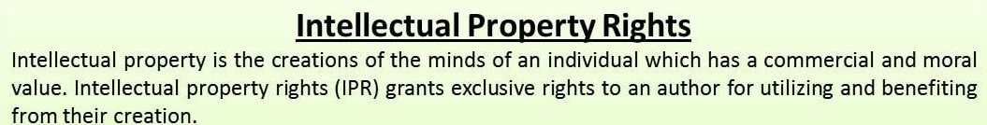

Slide 4
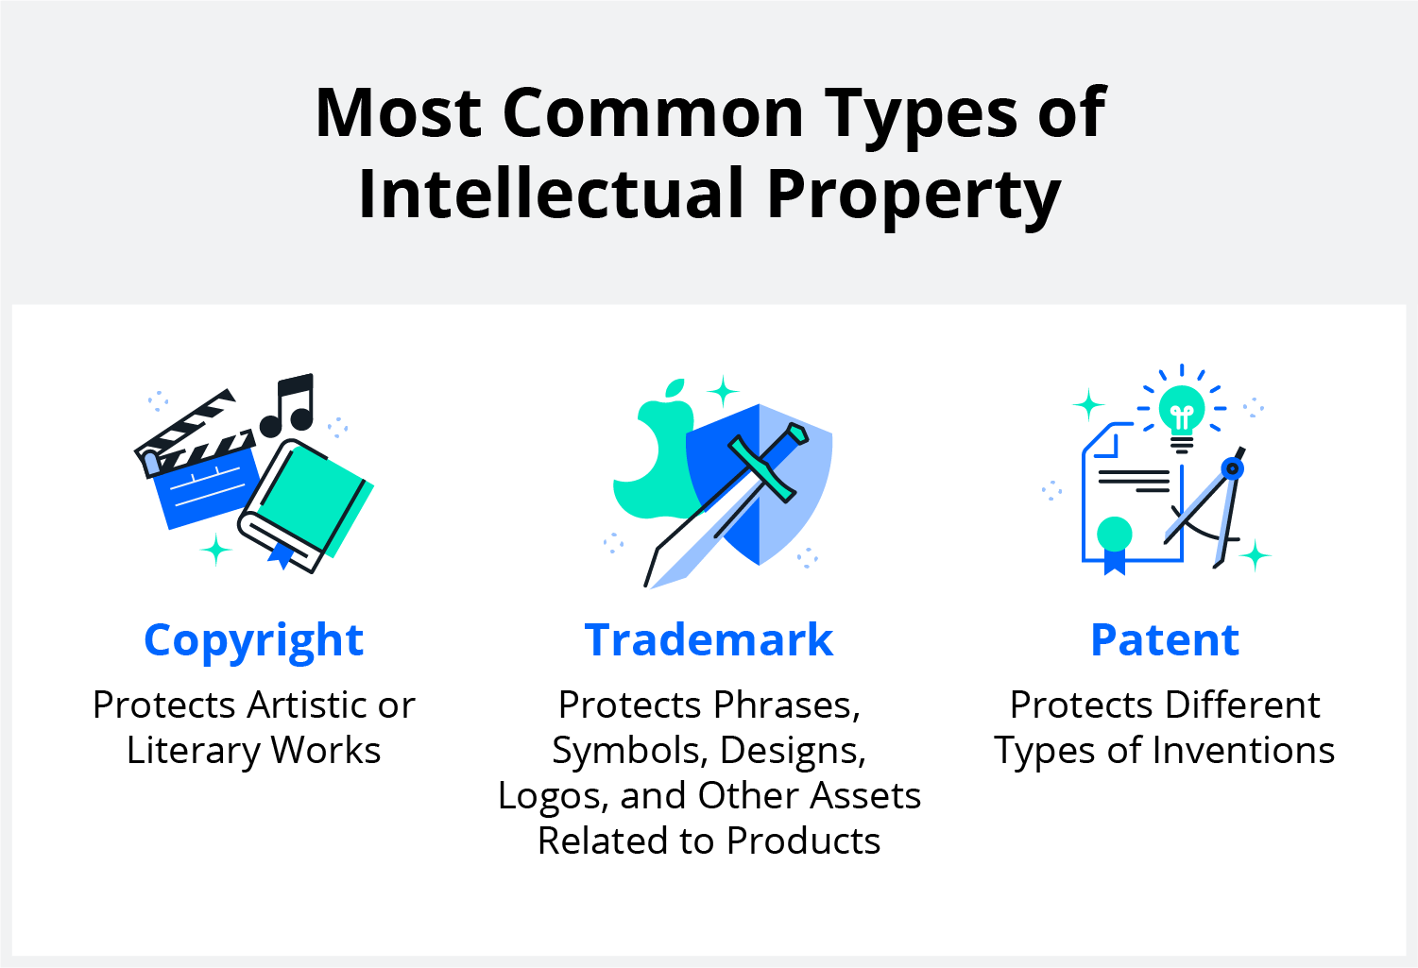

Slide 5
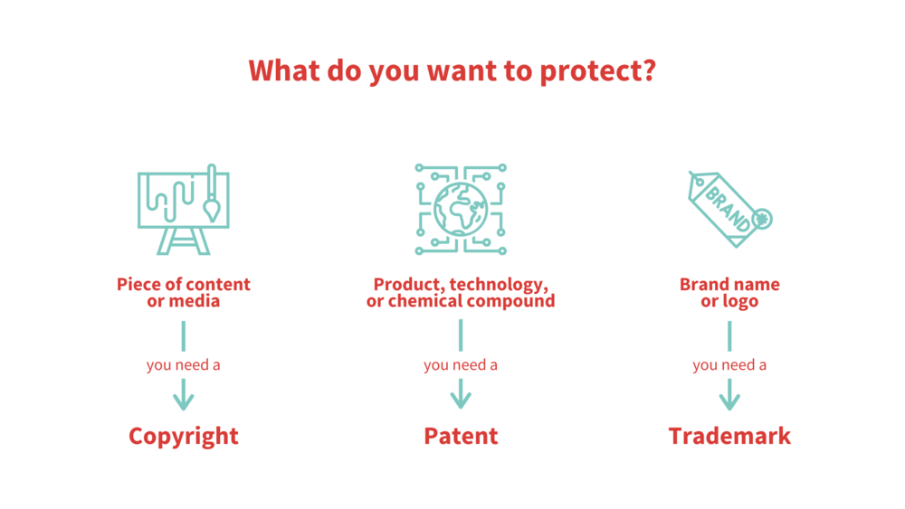

Slide 6
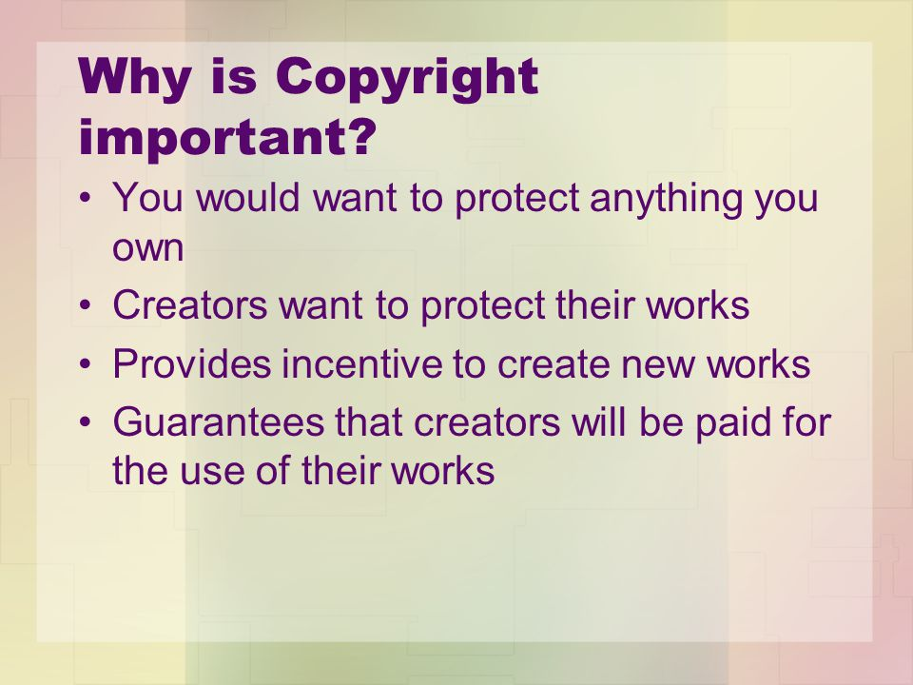

Slide 7
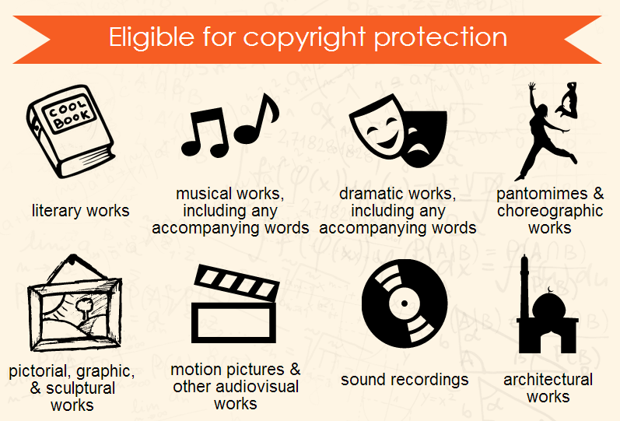

Slide 8
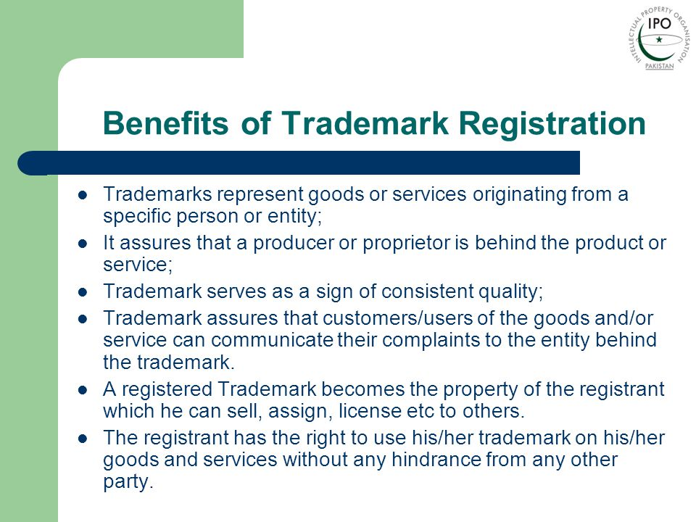

Slide 9

Example of trademark

Slide 10

Example of trademark

Slide 11

Example of trademark

Slide 12
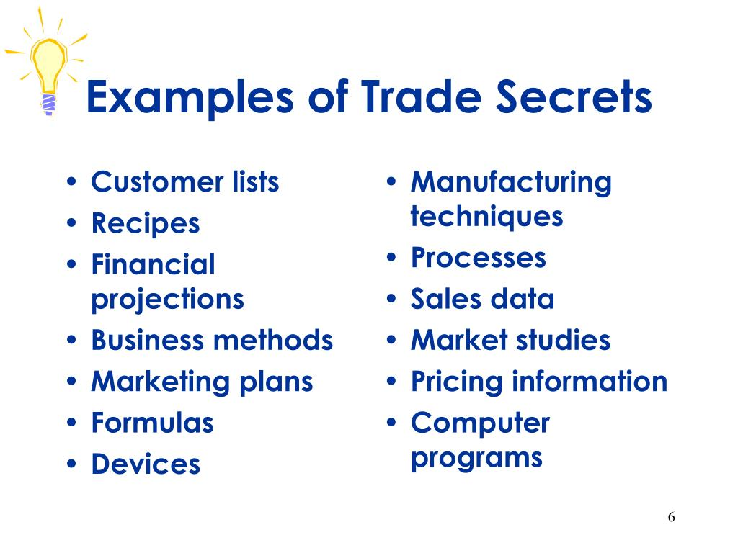

Slide 13
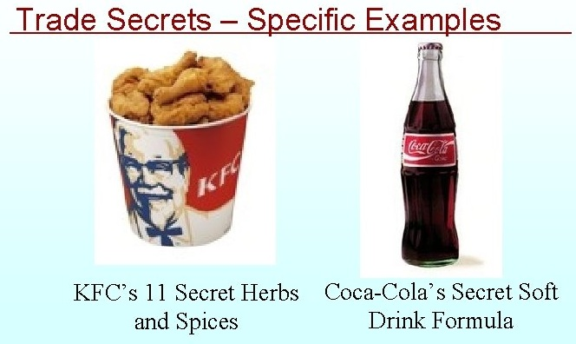

Slide 14
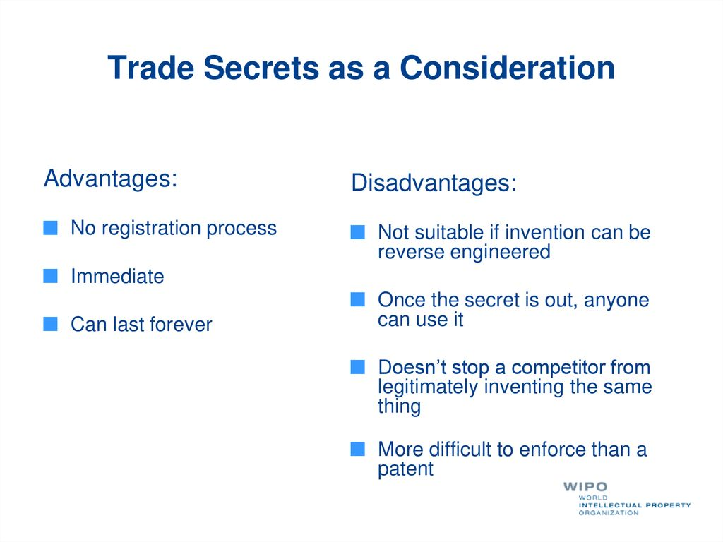
Based on Disadvantages of “Trade Secrets”…. We should go with ???? Patent…..

Slide 15

How important it is to know about “Intellectual Property Protection”?

Slide 16
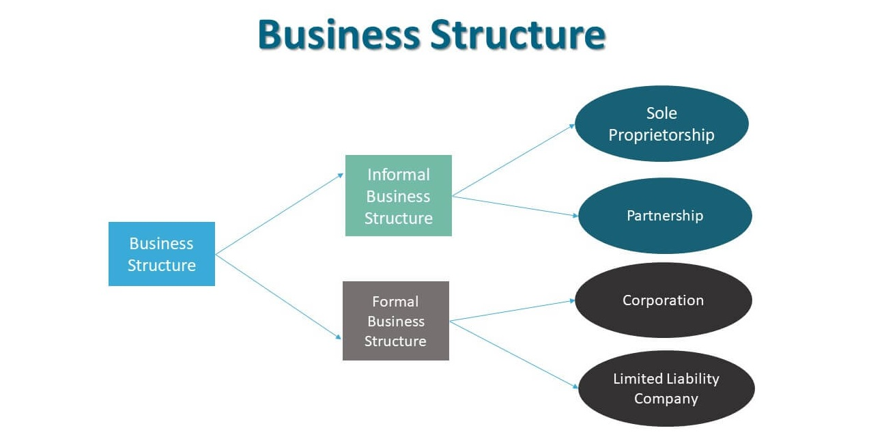
Legal Structures for Entrepreneurial Ventures

Slide 17
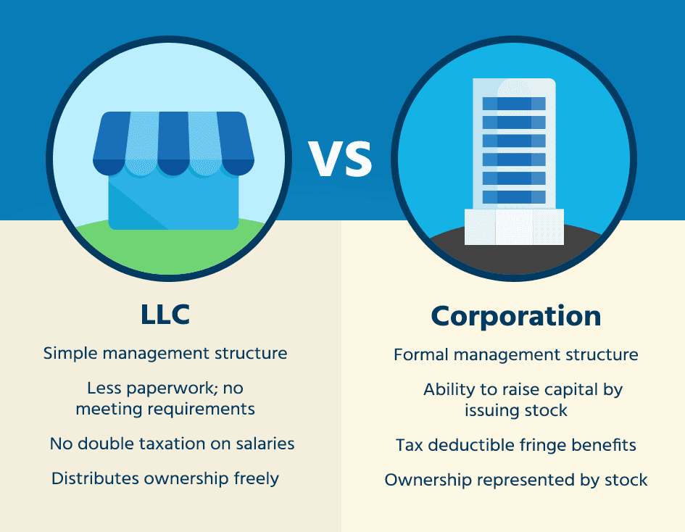
Legal Structures for Entrepreneurial Ventures

Slide 18
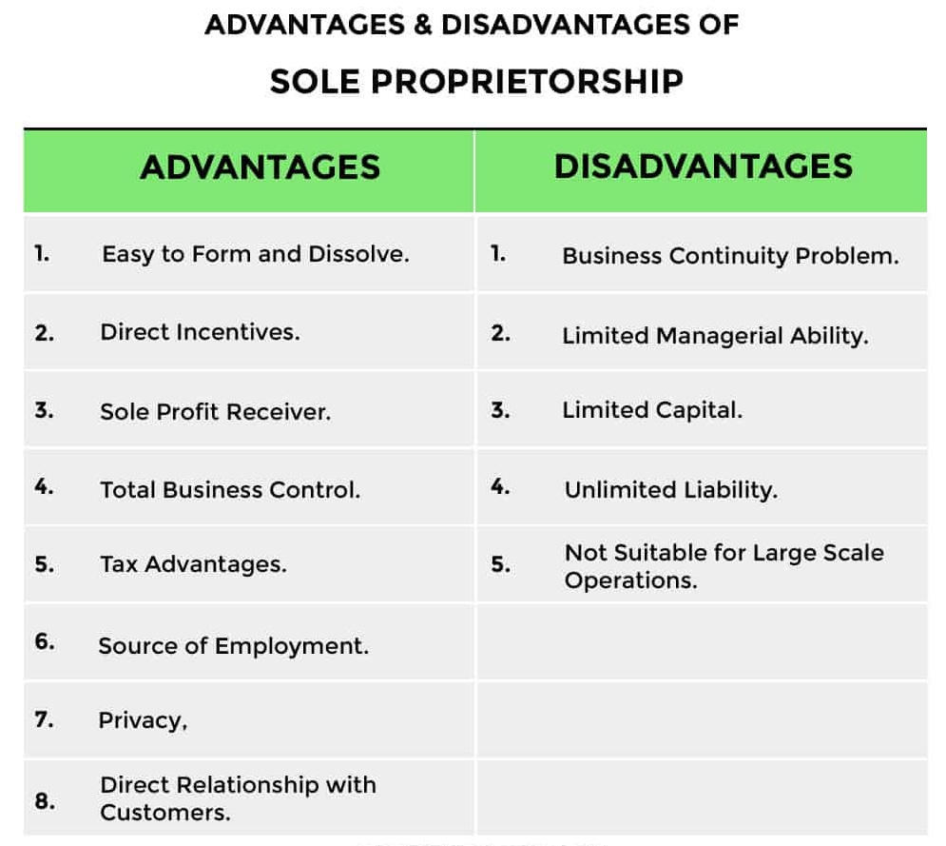

Slide 19
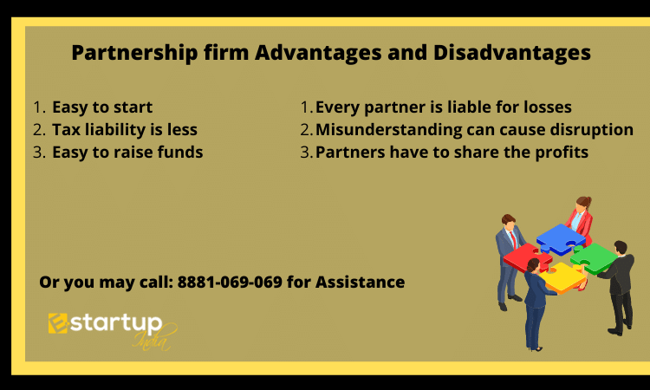

Slide 20
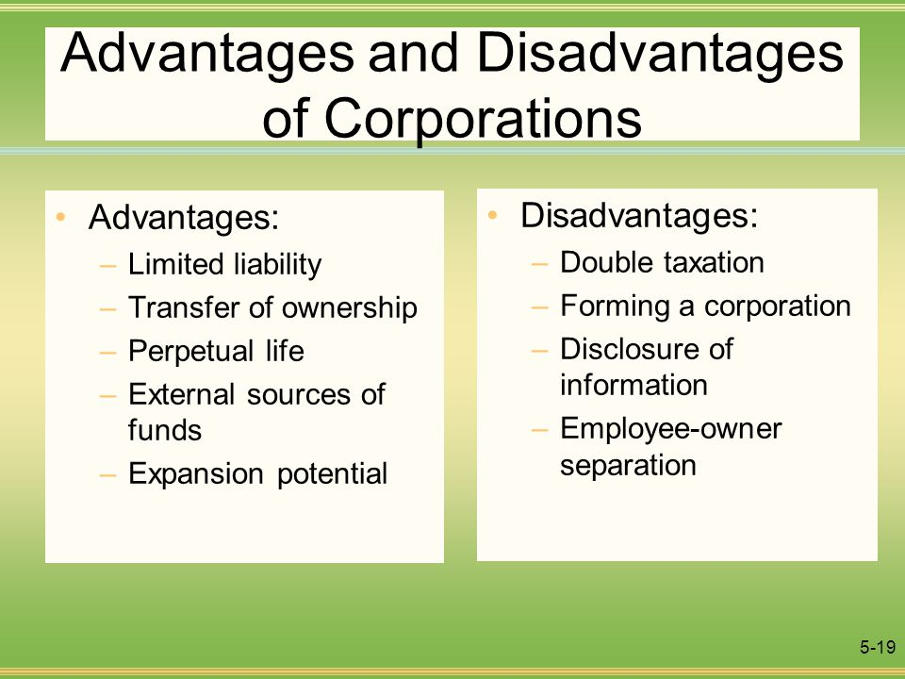

Slide 21
Advantages of LLC
Limited liability of the owners.
Positive public perception.
Easy transfer of proprietorship.
Tax advantages.
Disadvantages of LLC
Strict compliance (laws).
Winding up procedure is very lengthy.

Slide 22
Which one you think is the best way to form or start business?
Sole proprietor ship.
Partnership.
Limited Liability Company.
Corporations.

Slide 23


